Slide 1





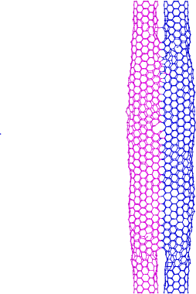



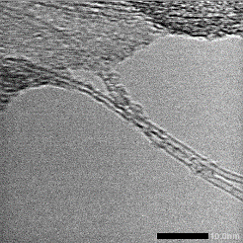
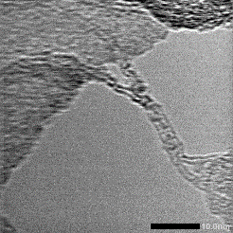

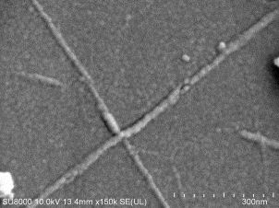
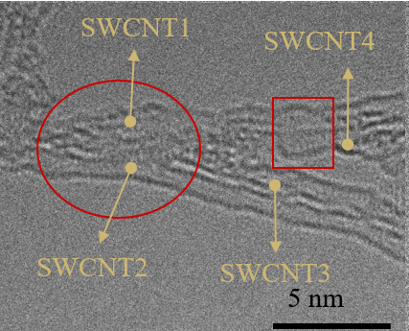

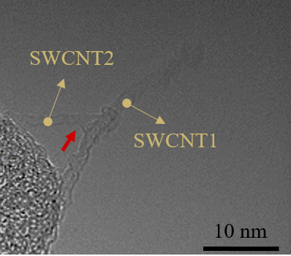

Minisymposia X:
Minisymposia Title
Poster Title (front size: 80, Bolded, Times New Roman or Arial)
Author 1ª，Author 2^{b}，Author 3^{c} et al. (author lists,)
ª School/Department Name, University/Institute, Country, Email
^{b} School/Department Name, University/Institute, Country, Email
^{c} School/Department Name, University/Institute, Country, Email
Introduction:
(a)
(b)
Single-Walled Carbon Nanotubes (SWCNTs), with their superior nanoscale properties, are supposed to be the ideal material for next-generation wiring. However, establishing chemical bonding between SWCNTs presents a formidable challenge. The interconnection process should be executed with precision, applying a heat source that induces a chemical reaction between SWCNTs without causing damage or introducing impurities. In this study, a high-energy laser beam was introduced to activate SWCNTs, causing them to chemical bonding with each other under the action of femtosecond pulse laser energy. Based on this technique, the electrical performance of the connected SWCNTs sensor was improved by nearly 63%. After 1000 repeated bending cycles, the response value of the sensor decreases only slightly, confirming its long-term reliability and durability. The uniqueness of femtosecond pulse lasers was utilized to overcome the limitations of traditional thermal and mechanical processes to achieve selectively effective interconnection of SWCNTs, providing a new possibility for the connection of SWCNTs in future integrated applications.
xxxxxxx.....
(Front: 32, Arial/Times News Roman, black, regular)
0 pulse
1 pulse
(c)
(d)
40 pulses
10 nm
10 nm
Figure example 1: MD simulation investigates the bonding mechanism of SWCNTs under femtosecond laser irradiation from the atomic scale. With the loading of laser, covalent bonds on sp² hybridized carbon atoms on the walls break and recombine. The dangling bonds or sp³ bonds were used as the transition state to help form the preliminary connection between SWCNTs and finally formed a stable connecting junction. Moreover, the connection process was exothermic, which was more conductive for its interconnection.
(Front: 28 or 32, Arial/Times News Roman, black, regular)
Results:
Methods:
Single-Walled Carbon Nanotubes (SWCNTs), with their superior nanoscale properties, are supposed to be the ideal material for next-generation wiring. However, establishing chemical bonding between SWCNTs presents a formidable challenge. The interconnection process should be executed with precision, applying a heat source that induces a chemical reaction between SWCNTs without causing damage or introducing impurities. In this study, a high-energy laser beam was introduced to activate SWCNTs, causing them to chemical bonding with each other under the action of femtosecond pulse laser energy. Based on this technique, the electrical performance of the connected SWCNTs sensor was improved by nearly 63%. After 1000 repeated bending cycles, the response value of the sensor decreases only slightly, confirming its long-term reliability and durability. The uniqueness of femtosecond pulse lasers was utilized to overcome the limitations of traditional thermal and mechanical processes to achieve selectively effective interconnection of SWCNTs, providing a new possibility for the connection of SWCNTs in future integrated applications.
xxxxxxx.....
(Front: 32, Arial/Times News Roman, black, regular)
Single-Walled Carbon Nanotubes (SWCNTs), with their superior nanoscale properties, are supposed to be the ideal material for next-generation wiring. However, establishing chemical bonding between SWCNTs presents a formidable challenge. The interconnection process should be executed with precision, applying a heat source that induces a chemical reaction between SWCNTs without causing damage or introducing impurities. In this study, a high-energy laser beam was introduced to activate SWCNTs, causing them to chemical bonding with each other under the action of femtosecond pulse laser energy. Based on this technique, the electrical performance of the connected SWCNTs sensor was improved by nearly 63%. After 1000 repeated bending cycles, the response value of the sensor decreases only slightly, confirming its long-term reliability and durability. The uniqueness of femtosecond pulse lasers was utilized to overcome the limitations of traditional thermal and mechanical processes to achieve selectively effective interconnection of SWCNTs, providing a new possibility for the connection of SWCNTs in future integrated applications.
xxxxxxx.....
(Front: 32, Arial/Times News Roman, black, regular)
(a)
Lens
CCD
(b)
(c)
(f)
Laser
Spectrometer
Mirror
500 nm
300 nm
Table example 1. Hyperparameters of working case settings for validation at the p-th order defined as n = 2,3,4,5,6 and corresponding output file size.
Detector
Lens
(d)
(e)
(g)
(Front: 28 or 32, Arial/Times News Roman, black, regular)
Computer
Sample
Platform
400 nm
400 nm
Figure example 2: (a)The schematic diagram of the femtosecond pulse laser irradiation system. (b-e) SEM image of SWCNTs with different junction types at 100 mW. (f-g) TEM image of SWCNTs with Y-type and T-type junctions at 100 mW.
(Front: 28, Arial/Times News Roman, black, regular)
References:
J. Kim, P. Moin, R. Moser, Turbulence statistics in fully developed channel flow at low Reynolds number. J. Fluid Mech. 177, 133–166 (1987). R. Vinuesa, S. L. Brunton, Enhancing computational fluid dynamics with machine learning. Nat. Comput. Sci. 2, 358–366 (2022).
(Front: 28, Arial/Times News Roman, black, regular)

